Slide 1
English to Indonesian Machine Translation
Team Members
ANURAG CHATTERJEE (A0178373U) BHUJBAL VAIBHAV SHIVAJI(A0178321H) GOH CHUNG TAT KENRICK(A0080891Y) LIM PIER (A0178254X) LIU THEODORUS DAVID LEONARDI (A0178263X)
Notes:
Ken

Slide 2
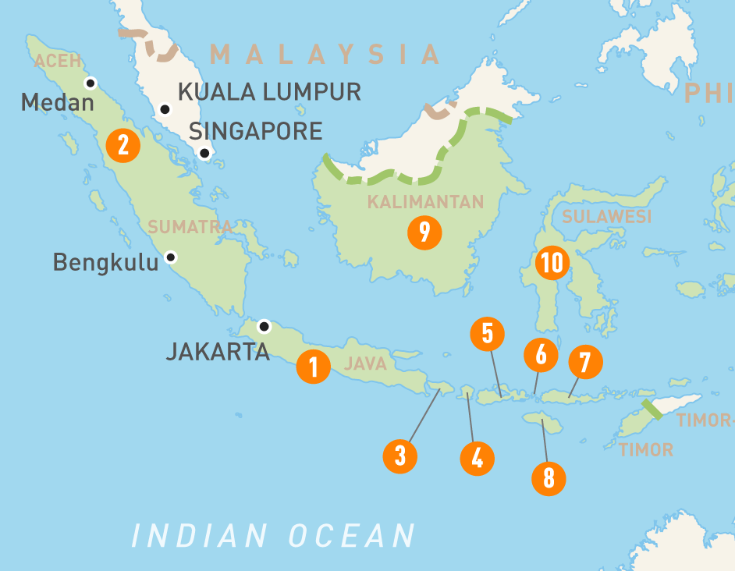
Background of Indonesia
The largest market in the SEA
Population of 264 million in 2017
Increasing Middle Class Group
Increasing Smartphone users (> 50% in 2018)
Internet Savvy
Main Language - Bahasa Indonesia
https://home.kpmg/content/dam/kpmg/sg/pdf/2018/07/ASEAN-GUIDE-Indonesia.pdf
https://www.techinasia.com/indonesia-worlds-fourth-largest-smartphone-2018-surpass-100-million-users
Notes:
Ken

Slide 3




Motivation
Translation of Business Document
Huge Business Opportunities in Indonesia
Translation of E-commerce Products
Communication with Locals during Holidays
Notes:
Ken

Slide 4
Dataset
No | Corpus Name | Sourced from | No. of pairs
1 | Manything_anki | Tatoeba | 6,752
2 | BBC-468.en | BBC | 468
3 | SMERU_en | SMERU Research Institute | 26,966
SMERU - We are truly grateful to the Family Court of Australia,
especially Leisha Lister, the executive adviser –
Kami sangat berterima kasih kepada Family Court of Australia,
terutama Leisha Lister, selaku penasihat eksekutif
Tatoeba (Chosen) - May I use your phone? -
Apakah saya boleh menggunakan ponsel Anda?
Split into 85% train and 15% validation
https://www.manythings.org/anki/ based on data from https://tatoeba.org/eng/
https://github.com/desmond86/Indonesian-English-Bilingual-Corpus
Notes:
Ken Eng – 3500
Indo - 4500

Slide 5
English to Indonesian Translation (Taken from Manything_anki corpus)
English | Indonesian
These are my boys | Mereka ini adalah anak-anak laki-lakiku
breakdowns
boy | anak laki-laki (anak: kid, laki-laki: man)
Plural form kids/children boys | Repeat the words anak-anak anak-anak laki-laki
Possessive form my [noun] – 1st person ownership E.g. my son / my boy his/her [noun] – 3rd person ownership E.g. his pencil | Possessive Form [noun] - ku anak laki-lakiku [noun] – nya pensilnya
Notes:
Ken

Slide 6
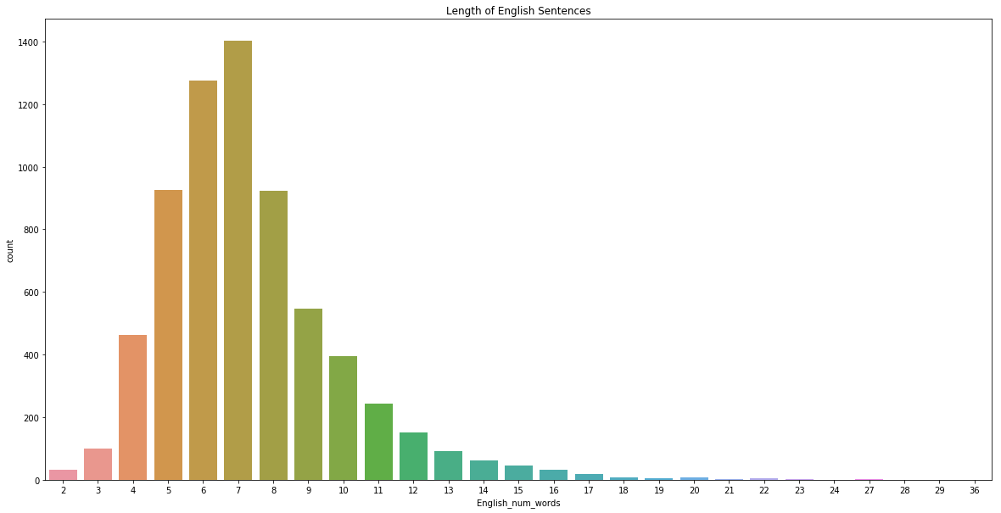
Length of English Sentences

Slide 7
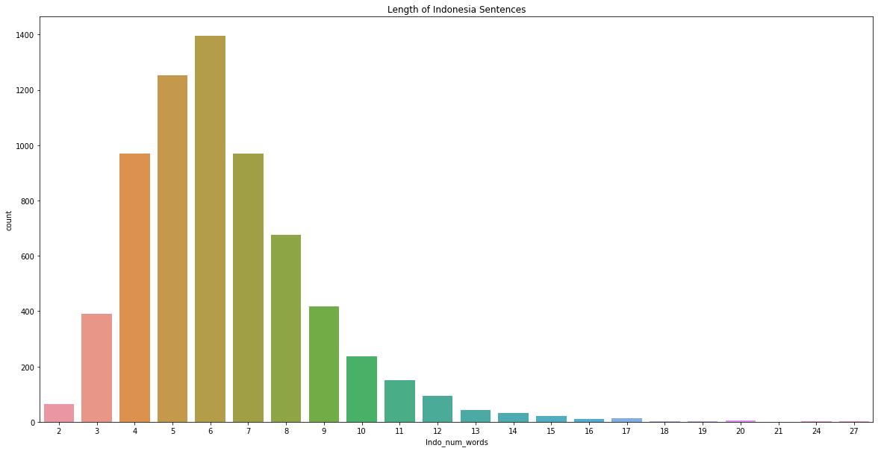
Length of Bahasa Indonesian Sentences

Slide 8
Model 1 : Seq-2-Seq
ENCODER
Training
Only vector that decoder receives is the hidden encoder representation
For training, teacher forcing = 50%
”Predicted” output is compared against the correct translation to determine loss
DECODER
Notes:
The first model we tried is based on Seq-2-seq, where the RNN that we used is GRU.
As you can see from the picture, each of the RNN produces a hidden state, that is seen here. The encoder representation seen here is the last hidden state stored by the last RNN cell.
To the decoder, all that is gets from the encoder portion here is the encoder representation.
So you can think of the encoder representation as a compressed representation of the encoder inputs.
So it now does a prediction of the output sequence based on the encoder representation and the actual translation.
Softmax is applied to the each of the outputs to normalize it across a vector of possibilities.
The word with the highest possibility will be selected as the output word.
We use negative log loss to do the loss calculation between these and the actual translation and back propagate it.
If you are generating the sentence, the decoding will end when the end-of-sentence is encountered.
Unfortunately, we weren’t getting great results with this model.
End off with ”the only thing that decoded sees is the encoder representation – so is there something more we can do ?

Slide 9
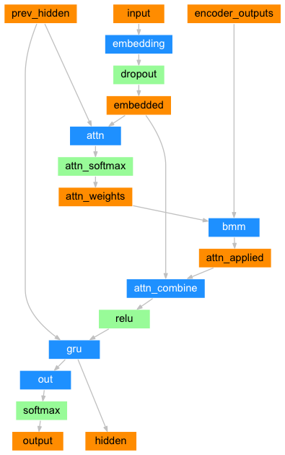
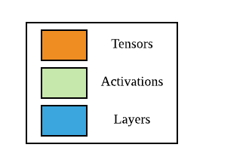
Model 2 : Seq-2-Seq with Attention
Vanilla model is limited by context vector representation
Introduce attention – help decoder choose right output words
Similar encoder network
Batch matrix multiplication to apply attention weights
Compare the translations – generally better translations compared to Vanilla
Risk over training – complex and not too large corpus!
How we translate?
Attention decoder
Source: https://pytorch.org/tutorials/intermediate/seq2seq_translation_tutorial.html
Notes:
Calculating the attention weights is done with another feed-forward layer attn, using the decoder’s input and hidden state as inputs. Because there are sentences of all sizes in the training data, to actually create and train this layer we have to choose a maximum sentence length (input length, for encoder outputs) that it can apply to. Sentences of the maximum length will use all the attention weights, while shorter sentences will only use the first few.
Embedding is from English vocab size to the hidden size (256), context vector generated of length 256 by GRU
Decoder:
Initialized with encoder hidden layer for the decode
Embedding from Indonesian vocab to hidden size (256), apply dropout to get embedding
Concatenate previous hidden with embedded into single linear layer which outputs max length set (so that we can multiply), apply softmax to get attn weights tensor
Multiplication of encoder outputs with the attention weights to get attn applied tensor
Concatenate with the embedding vectors generate hidden size, apply relu
GRU – previous hidden, attention combined input
Linear layer – input hidden size and output is size of Indo vocab
Apply log softmax to get output train using negative log likelihood
Training
Every iteration -> select random pair from input -> get encoder hidden, encoder output
Start with decoder input as SOS
No teacher forcing then select the top 1 as next input
Translate – convert to lower, tokenize, add sos, eos, unknown word, get indices from vocab, get decoded – if EOS then start
Eng – 3500
Indo - 4500

Slide 10
Training Strategy
 | Encoder | Decoder
Hyperparameter | No. of hidden layer nodes: 256 output size: (Indonesian vocab size) max iterations: 75000 learning rate: 0.01 Teacher forcing: 0.5 Dropout: 0.1
Optimizer | Stochastic Gradient Descent (SGD)
Layer initializations | Embedding (Normal distribution (0– 1)) Linear (Uniform distribution)
Stopping criteria |  | BLEU + loss function on validation set
Loss functions |  | The negative log likelihood loss (torch.nn.NLLLoss)
Activation |  | Log softmax (torch.nn.LogSoftmax)
Notes:
David – what is teacher forcing and why are we using it?

Slide 11
Evaluation Criteria
BLEU score
Evaluation metric ( Adapted from Lecture Notes)
Measures
1 = Easier to translate from scratch than to edit
a. Complete Garbage.
2 = Requires the same time to edit as translating from scratch
a. Very little of the meaning of the source sentence is captured.
b. Grammatical structures is not present in the translation.
3 = Requires some editing, easier to edit than translate from scratch
a. Some meaning of the source sentence is captured.
b. Acceptable grammatical structure
4 = Requires light editing
a. Almost all the meaning is captured.
b. Only light grammatical cleaning is required (Past Tense and Present Tense)
5 = Requires no editing
a. Good to Go.
Notes:
VB

Slide 12
Problems met
Over-training
Initially, did not have validation set
Translations were very good : happy
Initial corpus (BBC, SMERU)
Corpus was made up of sentences that was using formal language
Length of sentences : long sentences (80 words and above) didn’t give us good results
Translation was still not ideal
Pre-processing was done
Filtered based on prefix e.g. ”Tom is” , “I am”, “He is”: reduce complexity. It also eventually reduced the training data
Notes:
VB

Slide 13
What we will do next
Improve the translation quality
Words not in vocab
How should we handle it
Increase max number of words per sentence incrementally (if time permits)
Pre-trained language embeddings (if time permits)
Notes:
VB

Slide 14
Thank you

